Slide 1


ABMSP’S ANANTRAO PAWAR COLLEGE OF ENGINEERING
Parvati , pune-28
Topic Name:- AUTOMATED PARALYSIS PATIENT HEALTHCARE MONITORING SYSTEM
Presented By:-
*Manthan Jadhav
*Aniket Zanje
*Pavan Jadhav
*Vishnu Rathod
-Project Guide:- Mr. A.N. Kalal

Slide 2
INTRODUCTION
It has been scientifically proven that people of all ages and conditions that regularly practice physical activity and sports benefit from a wide range of physical, social and mental health benefits. Fitness increases productivity, interacts positively with diet, enhances functional capacity, promotes social interaction, and reduces health care costs.
Companies and researchers worldwide are devoting an increasing attention to sports, fitness and physical activities. An athlete always needs to monitor , watch and record your daily burned calories and step counts , body temperature.
Self-tracking allows them or normal people to stick to a healthier diet, exercise more and sleep better. Regular use of fitness tracker boosts your daily workouts and makes them achievable.

Slide 3
PROBLEM STATEMENT
In today’s social Health Insurance structure where patients stay at home after Operations they are not possible monitored 24-hours by a medical caretaker or a family member so. Many people now a days who work full time are facing a problem of monitoring especially old age patient’s. So to overcome this problem we are using this patient health monitoring system using IOT.

Slide 4
GOALS AND OBJECTIVES
Goals -
Where we see a problem with these types of devices that are being developed is that they are very large and expensive machines, They seem to be only available in hospitals and not able to be used at the patient’s home or at their convenience.
2. Our goal is to make a device that will be help the patient fully monitoring stay at home after operation and able to retrain a patient’s motion but have them be able.

Slide 5
Objectives -
Because of expanding work cost, medical institutions would constrain to decrease nursing staff for patients. Our project aims to develop new innovation for the use of basic nursing care. It helps us to take care of patient health care without nurse.
This system also takes care of the situation wherein no one is present to attend the patient and thus sending a message through GSM of what he wants to convey in SMS and also sound a speaker along with message.

Slide 6
PROBLEM STATEMENT / TITLE BASED ON LITERATURE SURVEY
Methodology, only there exists the technology of monitoring the patient heart rate in the nearby terminal display unit and the remote monitoring is enabled only when there exists the WIFI connectivity.
Proposed a Smartphone based remote patient monitoring system. In this system, a Smartphone application (app) is implemented. Patient can have a video conference with the doctor by using a Smartphone to discuss the treatment process.
This paper presents the implementation of automated IoT based healthcare system for remotely located patients which helps doctors and guide them accordingly. The system provides alerts by the means of E-mails in case of abnormal conditions observed in the monitoring parameters of the patient.
The author in paper proposed the system that makes use of mobile phone’s inbuilt Bluetooth facility for automation without using Air Time. The author in paper have described different hardware and software units that make complete application software design for paralyzed patients.

Slide 7
LITERATURE SURVEY
AUTORE | PROJECT NAME | PUBLISHED
J S Sujin; S Mukesh;M J Praveen Raj; M Sashwanth; R Ramesh Kumar. (2021,march). | “IoT based Patient Monitoring System using IoT.” | 7th International Conference on Advanced Computing and Communication Systems (ICACCS).
Zainab Pirani; Afiya Momin; Anood Kadri; Arafat Shaikh (2018,april). | “Survey of Numerous Accessible Applications for Paralysis Patients.” | Second International Conference on Intelligent Computing and Control Systems (ICICCS).
Hoe Tung Yew; Ming Fung Ng; Soh Zhi Ping; Seng Kheau Chung; Ali Chekima; Jamal A. Dargham (2020, july). | “IoT Based Real-Time Remote Patient Monitoring System.” | 16th IEEE International Colloquium on Signal Processing & Its Applications (CSPA).
OBSERVATION
This process of continuously tracking the patient’s vital parameters suggested by the doctor. is designed to help the patient to convey their health issues/status.
In this system is availability, flexibility, high speed, reduce cost of wiring and simple use of technologies.
This paper proposes an IoT based real-time electrocardiogram (ECG) monitoring system that is able to support both real-time and store-and-forward modes.

Slide 8
LITERATURE SURVEY
AUTORE | PROJECT NAME | PUBLISHED
Rani G. Utekar;Jayant S. Umale (2019, june). | “Automated IoT Based Healthcare System for Monitoring of Remotely Located Patients.” | Fourth International Conference on Computing Communication Control and Automation (ICCUBEA).
Sukanya Vuppala (2020,December) | “E-Fitness Implementation in Metro Rail using IoT with help of 5G“ | IEEE 12th International Conference on Humanoid, Nanotechnology, Information Technology, Communication and Control, Environment, and Management (HNICEM)
Tonny Heng Yew Ling (2021,April) | “IoT Fitness Device with Real Time Health Assessment and Cloud Storage“ | 2021 International Wireless Communications and Mobile Computing (IWCMC)
OBSERVATION
In this paper the patient can using mobile phone automatically handle home hardware and software.
In this paper we have to reduce mental pressure and improves the physical strength and fitness Using IoT
In this paper this device monitors the heart rate and temperature of the human body using Arduino Uno as the main microcontroller

Slide 9
SYSTEM OVERVIEW
Proposed System -
Paralysis is the inability to move muscles on your own and with purpose. It can be
temporary or permanent. The most common causes are stroke, spinal cord injury, and multiple
sclerosis. Paralysis can be a complete loss of movement known as plebeian, or a significant
weakness called paresis. Even though, there are innovative approaches for curing or treating
paralysis patients, but the aim of treatment is to help a person adapt to life with paralysis by
making them as independent as possible. Where we see a problem with these types of devices
that are being developed is that they are very large and expensive machines. They seem to be
only available in hospitals and not able to be used at the patient’s home or at their convenience.
Our goal is to make a device that will be able to retrain a patient’s motion but have them be able
to use the device themselves and have it been cheap enough for them to afford without much debt.

Slide 10
Proposed Outcomes
➢ Easy to implement and manage
➢ Increased productivity
➢ Eliminates human error
➢ Reduces cost
➢ Improves patient care and satisfaction
➢ Increases security through audit trails
➢ Maintains regulatory compliance
➢ Easily integrates with existing systems

Slide 11
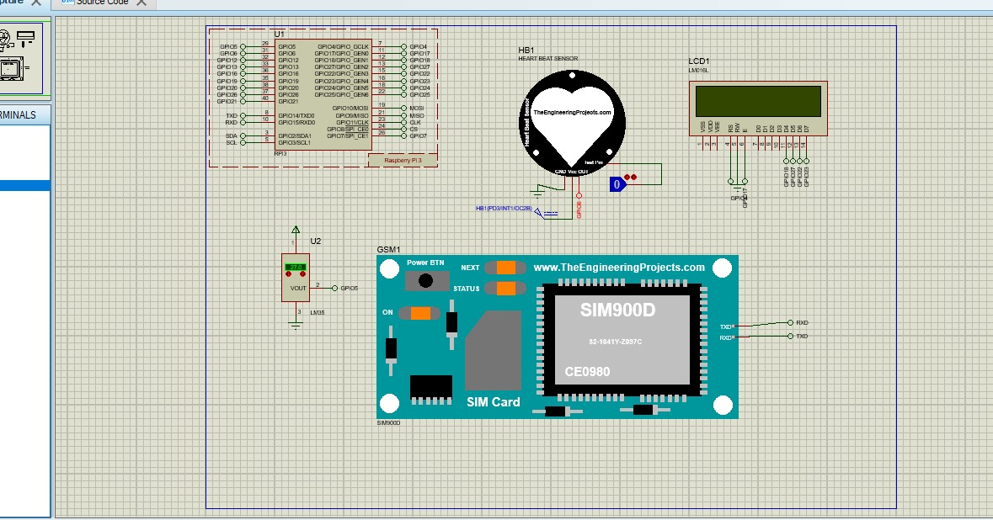
PROPOSED SYSTEM ARCHITECTURE:-

Slide 12
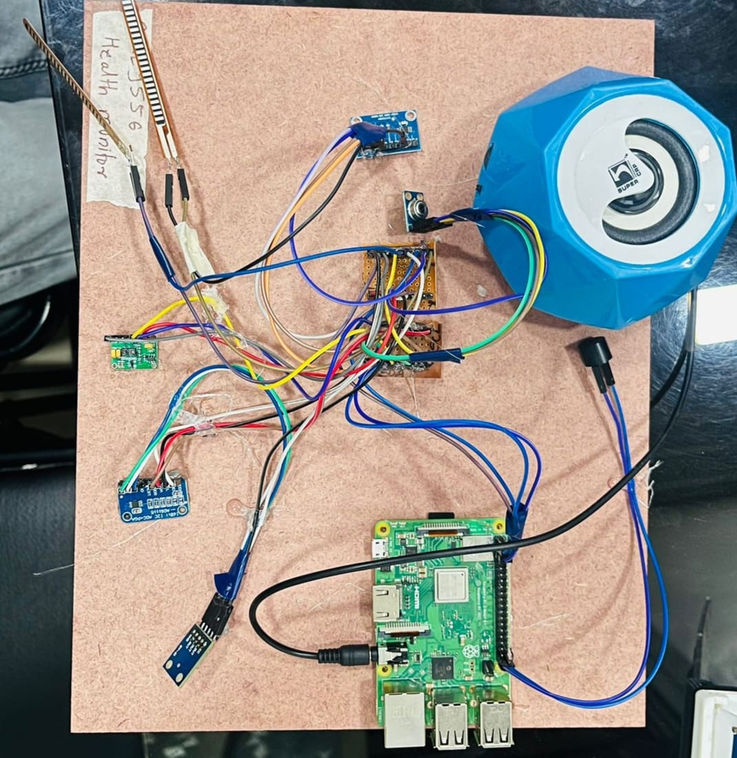
Circuit Of PROPOSED SYSTEM:-

Slide 13
Architecture of Module
Power Supply
Temp Sensor
Flux Sensor 1
Flux Sensor 2
Heart Rate
Raspberry Pi
Things Speak
Accelerometer

Slide 14
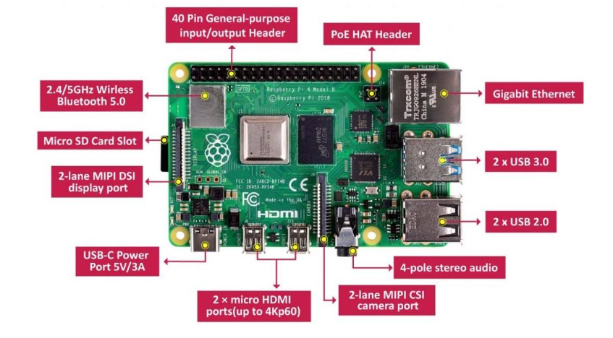
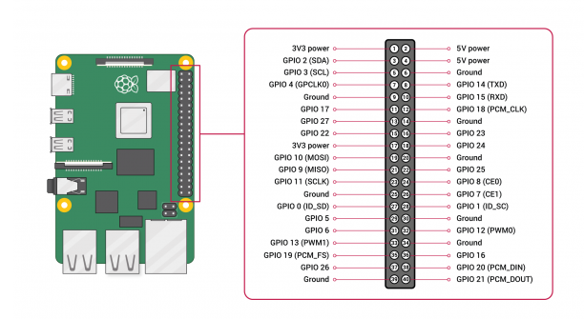
Raspberry Pi Diagram With Pins:

Slide 15
Methodology:
Raspberry Pi:
Raspberry Pi is the name of a series of single-board computers made by the Raspberry Pi Foundation, a UK charity that aims to educate people in computing and create easier access to computing education
Heart rate sensor :- A pulse wave is the change in the volume of a blood vessel that occurs when the heart pumps blood, and a detector that monitors this volume change is called a pulse sensor.
Flex sensor :- A heat flux sensor is an instrument used to measure the rate of heat energy transfer per unit area. It is a transducer which generates electrical signal (output voltage) which will be proportional to this measure of heat rate.
Temperature sensor :- A temperature sensor is a device that detects and measures hotness and coolness and converts it into an electrical signal.
Accelerometer Sensor:- accelerometer sensors are mainly operated in step counting, activity monitoring or motion work and suppression. It is a device that measures the vibration, or acceleration of motion of a structure

Slide 16
DFD LEVEL:0
Heart Sensor
Temp Sensor
Flux Sensor
Computer System
Mobile
Patient
Check Pulse
Check Temp
Patient Activity Check
Input
Send SMS

Slide 17
DFD Level:1
17
High Pulse
Convey
Different Messages
Mobile
Patient
Heart Sensor
Temp Sensor
Flux Sensor
Computer System
Check Pulse
Check Temp
Patient Activity Check
Input
Send SMS
Low Pulse
Check Temp

Slide 18
UML Diagram:- Use Case Diagram
Flux Sensor
Start System
Temp sensor
Monitoring System
System
Patient
Heart sensor
Controller
Accelerometer Sensor
Alter SMS
User

Slide 19
UML Diagram:- Class Diagram
Sensor
Equbement
User
Controller
Transformer
Temp Sensor
User ID
Password
Heart Sensor
Flux Sensor
Accelerometer Sensor
+Read Data
+Write Data
+Send Data
+show results
+Handle System
+On System
+Readout Data
+Share Data
+Execute Work
Monitoring System
Patient
Display
Name
Address
Mobile No
Patient ID
+Connect to Internet
+Send SMS
+Readout Data
+Whiteout Data

Slide 20
UML Diagram:- Activity Diagram:
System Open
Controller
Temp Sensor
Checking Temp Patient
Temp Sensor
Send Reading SMS
Checking Accelerometer Patient
Send Reading Accelerometer Status SMS
Accelerometer
Checking Pulse Rate Patient
Send Reading Pulse Rate In SMS
Heart Rate Sensor
Checking what Patient Convey
Flux Sensor
Send Reading SMS
Sound Through What Patient Convey

Slide 21
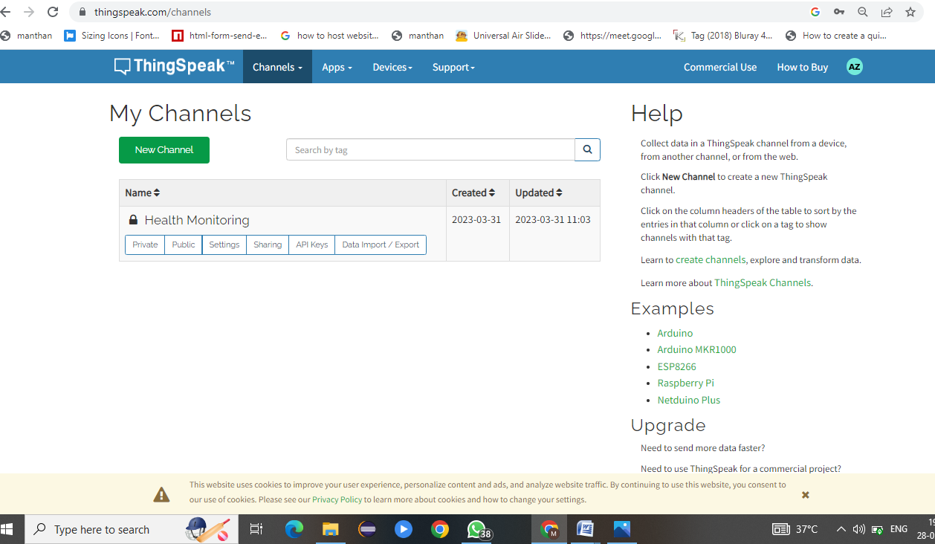
IMPLEMENTATION:-
User-interface Profile

Slide 22
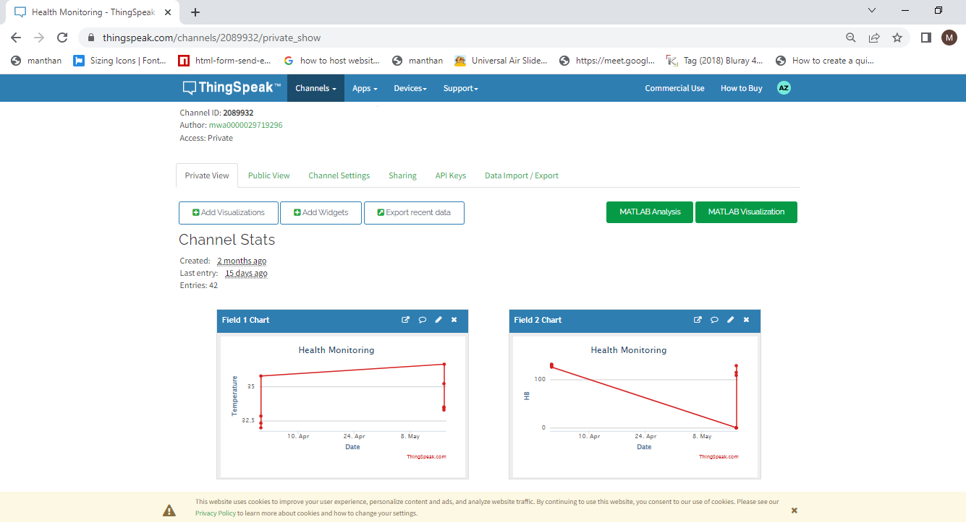

Slide 23
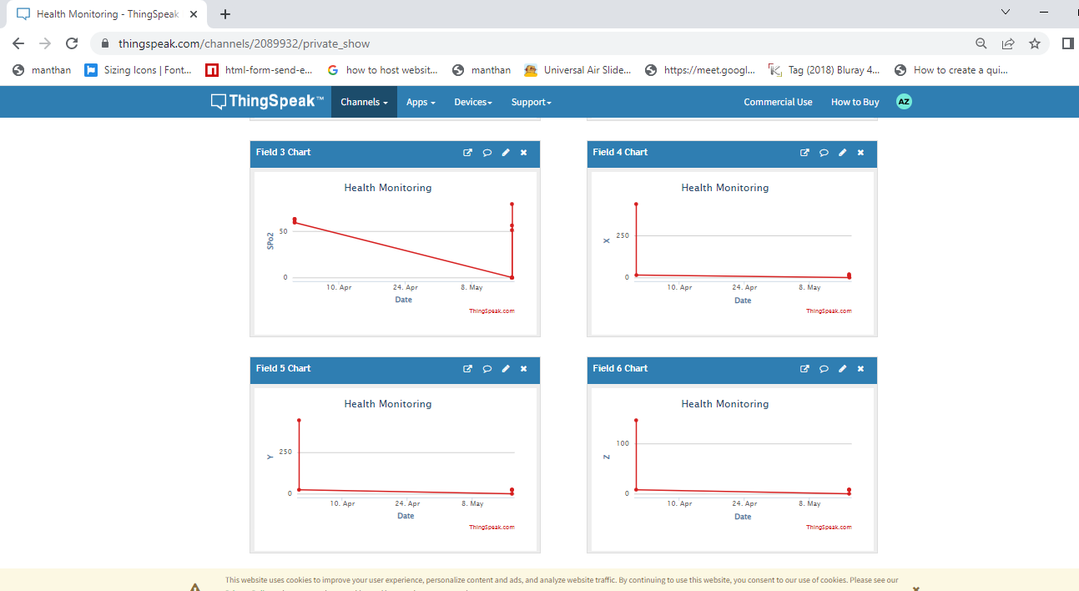

Slide 24
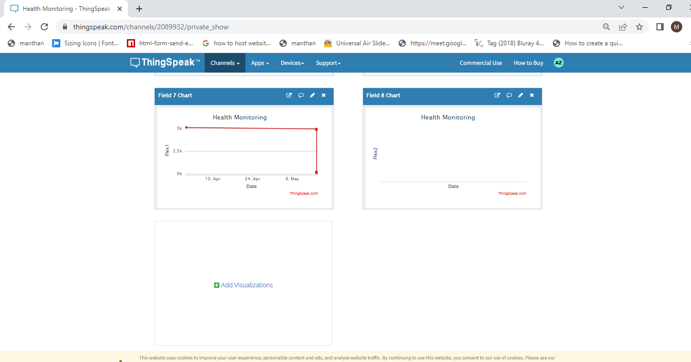

Slide 25
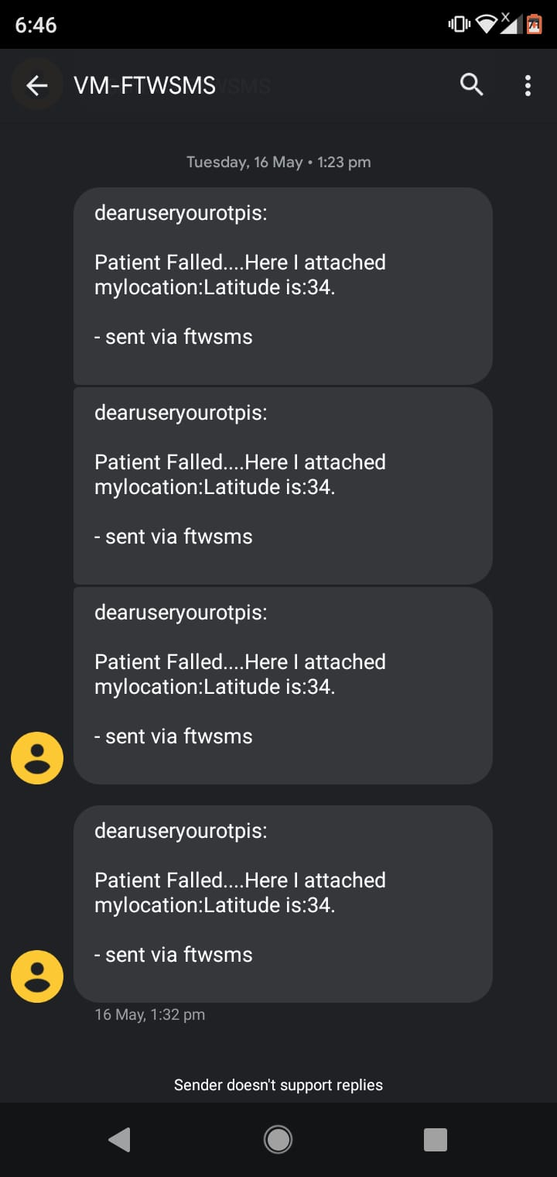

Slide 26
LIST OF REQUIRED HARDWARE , SOFTWARE
Software requirement
1. Language: Python
Hardware Specification
1.Raspberry Pi
2.Accelerometer
3.Temp Sensor
4.Heart rate Sensor

Slide 27
CONCLUSION
All in all, this project achieved a lot of its goals. The project implemented a low cost, low power, LCD pulse rate display system using microcontroller technology. Lists of accomplishments include portability, reliability and analog to digital conversion and also the system is easily accessible.
Our system successfully proves that this system is an excellent approach to be implemented at hospitals for patient-nurse communication.
The ease of message conveyance is the main advantage of this system along with the real time user defined medicine alarm. By implementing this system, a simple device for paralyzed or disabled people can be achieved without the use of complex form of inputs.
can also be transmitted to the nurse so that a real time record of all the patients is maintained.

Slide 28
Future Scope
Recommendation for future works is to fitness is a measure of human being’s healthy status. People pursue fit lives through various ways such as reasonable nutrition, regular exercise and sufficient sleep.
Fitness is improving through smart wearable's more and more popularly with the prevalence of Internet of Things and smart phones

Slide 29
REFERENCES
J S Sujin; S Mukesh;M J Praveen Raj; M Sashwanth; R Ramesh Kumar. (2022,march) "IoT based Patient Monitoring System using IoT". 7th International Conference on Advanced Computing and Communication Systems (ICACCS).
Zainab Pirani; Afiya Momin; Anood Kadri; Arafat Shaikh (2021,april) "Survey of Numerous Accessible Applications for Paralysis Patients". Second International Conference on Intelligent Computing and Control Systems (ICICCS).
Akshat; Gaurav; Zahid; Bhupendra; Aditi; Sachin Kumar; Maneesha; Praveen Pandey (2020, may) "A Smart Healthcare Monitoring System Using Smartphone Interface". 4th International Conference on Devices, Circuits and system (ICDCS).
Rani G. Utekar; Jayant S. Umale (2019, june) "Automated IoT Based Healthcare System for Monitoring of Remotely Located Patients". Fourth International Conference on Computing Communication Control and Automation (ICCUBEA)
Sukanya Vuppala (2020,December) "E-Fitness Implementation in Metro Rail using IoT with help of 5G”.
Tonny Heng Yew Ling (2021,April) "IoT Fitness Device with Real Time Health Assessment and Cloud Storage”

Slide 30

THANK YOU
ANY QUESTION?

